Slide 1


Chiara Brambilla
9 March 2023

Slide 2

Outline
Executive Summary
Introduction
Methodology
Results
Conclusion
Appendix

Slide 3
Executive Summary
In order to determine the cost of a launch, we predict whether the first stage of SpaceX Falcon 9 will land successfully.
The methodologies used to achieve this goal include Data Collection, Data Wrangling and Data Pre-processing, Exploratory Data Analysis (with SQL and visual tools), and Machine Learning algorithms.
Our analysis emphasises that some features are strictly related to a higher rate of success of rocket launches. Moreover, our research points out which is the best machine learning algorithm for this problem.

Slide 4
Introduction
SpaceX declares that Falcon 9 rocket launches cost of 62 million, while other providers cost upward of 165 million dollars each. Much of the savings is because SpaceX can reuse the first stage. If we can determine if the Falcon 9 first stage will land, we can determine the cost of a launch. This information can be used to bid against SpaceX for a rocket launch.
The main goal of this capstone is to collect and analyze data to answer the following question:
Will the Falcon 9 first stage land successfully?

Slide 5

Section 1

Slide 6
Methodology
Executive Summary
Data was collected both from SpaceX API and from Wikipedia by Web Scraping. In the first case we perform data wrangling by cleaning and ensuring data structure, while in the other case we parse HTML table and convert it data frame using Python’s Pandas library.
We perform some Exploratory Data Analysis (EDA) to find some patterns in the data. We visualize information using Python’s Pandas and Matplotlib libraries and use SQL queries to understand the data set. We perform interactive visual analytics using Folium and Plotly Dash.
Finally, we perform predictive analysis using different classification models. All models were trained and their best hyperparameter’s were found. Then, we evaluate them to find which is the best one.

Slide 7
Data Collection – SpaceX API
Use GET request to obtain data from SpaceX API
Create a Pandas dataframe from a dictionary
Filter the dataframe to only include Falcon 9 launches
Normalize JSON response into a Pandas dataframe
Use the API again to get specific information
Dealing with Missing Values
Export it to a CSV
GitHub URL:
Data Collection API

Slide 8
Data Collection - Scraping
Obtain Falcon9 Launch data from Wikipedia page
Parse launch HTML tables to create a data frame
Export it to a CSV
Create a BeautifulSoup object from the response
Extract column names from the HTML table header
GitHub URL:
Data Collection with Web Scraping

Slide 9
Data Wrangling
Calculate the number of launches on each site
Create a landing outcome label from Outcome column
Export it to a CSV
Calculate the number and occurrence of each orbit
Count mission outcomes per orbit type
GitHub URL:
EDA

Slide 10
EDA with Data Visualization
Scatter plots: to display how different variables would affect the launch outcome. Different couples were considered:
Flight Number vs Payload Mass, Flight Number vs Launch Site, Payload vs Launch Site, Flight Number vs Orbit type, Payload vs Orbit type.
Bar chart: to visualize the relationship between different variables, such as Success Rate and Orbit type
Line chart: to visualize trends over time, such as Launch Success yearly trend
GitHub URL:
EDA with Data Visualization

Slide 11
GitHub URL:
EDA with SQL
EDA with SQL
Display:
names of the unique launch sites in the space mission
5 records where launch sites begin with the string 'CCA'
total payload mass carried by boosters launched by NASA (CRS)
average payload mass carried by booster version F9 v1.1
List:
date of the first successful landing outcome in ground pad
boosters with success in drone ship and payload mass between 4000 and 6000
total number of successful and failure mission outcomes
booster versions’ names which have carried the maximum payload mass
failed landing outcomes in drone ship, with booster versions and launch site names for 2015
Rank:
count of landing outcomes between 2010-06-04 and 2017-03-20 , in descending order

Slide 12
GitHub URL:
Interactive Visual Analytics with Folium lab
Build an Interactive Map with Folium
To find geographical patterns about launch sites, we complete the tasks:
Add markers to identify launch sites and circles to highlight the area
Add markers to display success/failed launches for each site
Add lines to compute distances of a launch site and answer the questions:
Are launch sites close to railways? YES
Are launch sites close to highways? YES
Are launch sites close to coastline? YES
Do launch sites keep certain distance away from cities? YES

Slide 13
Build a Dashboard with Plotly Dash
The Dashboard application display:
a pie chart to show the total successful launches count for all sites or the success rate for specific selected site
a scatter chart to show the correlation between payload and launch success for a selected site and range of payload mass
GitHub URL:
SpaceX Dash App

Slide 14
Predictive Analysis (Classification)
Create a column for “Class”
Find best hyperparameter for SVM, Classification Trees, K-nearest neighbors and Logistic Regression
Find the method performs best using test data
Standardize the data
Split into training and test data
GitHub URL:
Machine Learning Prediction

Slide 15
Results
Exploratory data analysis shows that the success rate since 2013 kept increasing till 2020.
Interactive analytics is very useful to understand that launch sites are very close to highways and railways making transport easier, but they are quite distant from cities for security reasons.
Predictive analysis compares different methodologies and points out that decision tree classifier gets the best test accuracy score and fit accuracy.

Slide 16

Section 2

Slide 17
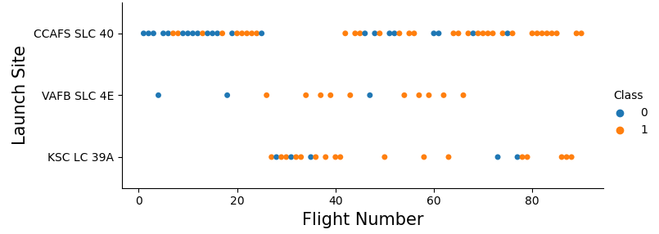
Flight Number vs. Launch Site
Class 0 represents the unsuccessful launches
Class 1 represents successful launches
Success rate increased with the number of flight.
Different launch sites have different success rates: CCAFS LC-40 has a success rate of 60 %, while KSC LC-39A and VAFB SLC 4E have a success rate of 77%.

Slide 18
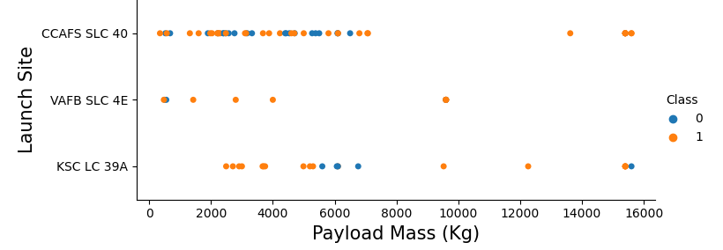
Payload vs. Launch Site
Class 0 represents the unsuccessful launches
Class 1 represents successful launches
No relationship is pointed out.
However, we observe that VAFB-SLC launch site has no rockets launched for heavy payload mass, i.e., greater than 10000.

Slide 19
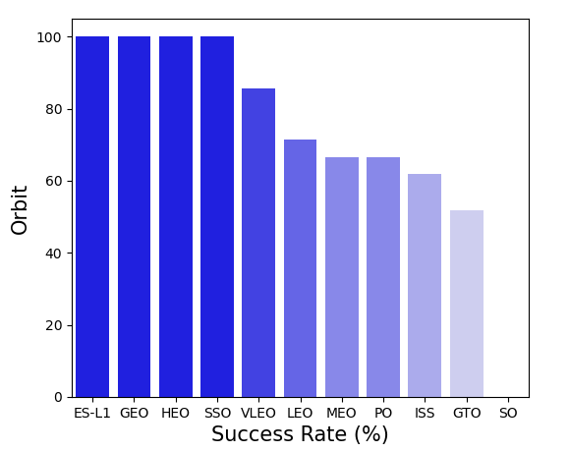
Success Rate vs. Orbit Type
Four orbits have success rates equal to 100%. They are ES-L1, GEO, HEO and SSO.
SO orbit has a success rate of 0%.

Slide 20
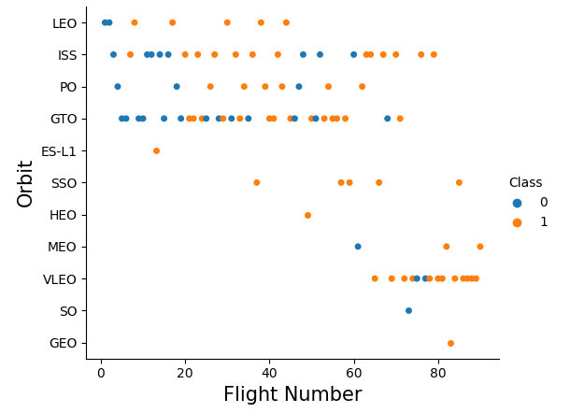
Flight Number vs. Orbit Type
Class 0 represents the unsuccessful launches
Class 1 represents successful launches
LEO orbit increase its success with the number of flights.
SSO has a 100% rate of success.
No relationship can be found considering GTO orbit. In general, success rate increase with number of flights.

Slide 21
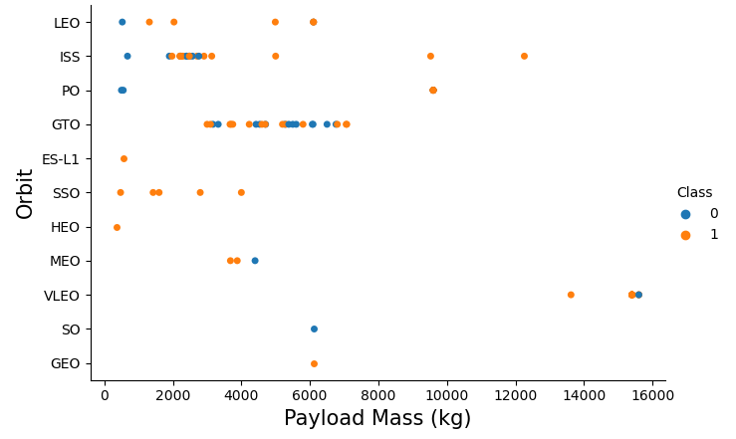
Payload vs. Orbit Type
Class 0 represents the unsuccessful launches
Class 1 represents successful launches
Success landing rate increases with heavy payloads for LEO, ISS and Polar.
We cannot conclude for GTO.

Slide 22
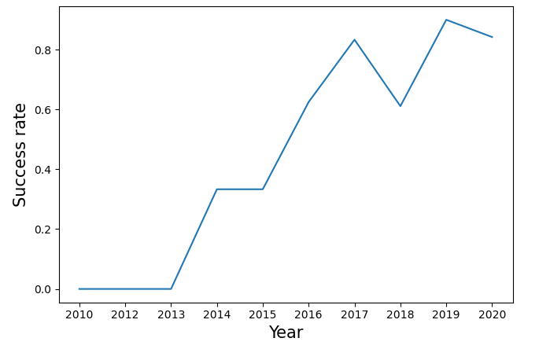
Launch Success Yearly Trend
The success rate has a general increasing shape from 2013 to 2020.

Slide 23
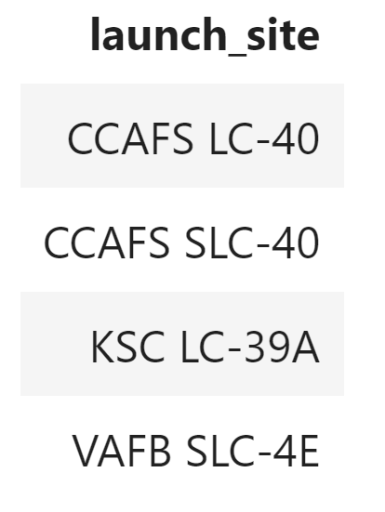
All Launch Site Names
Using DISTINCT in the SQL query, we select all launch sites.
They are:
CCAFS LC-40
CCAFS SLC-40
KSC LC-39
VAFB SLC-4E

Slide 24
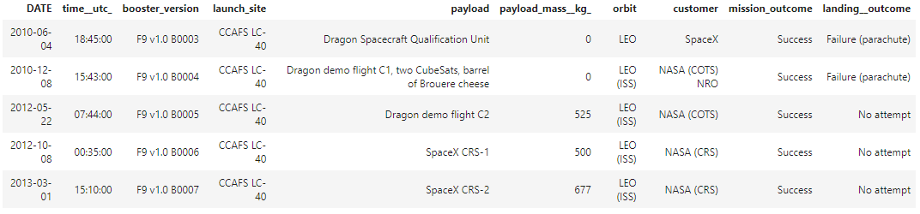
Launch Site Names Begin with 'CCA'
The data displays 5 records where launch sites begin with `CCA`.
The SQL query uses LIKE in the WHERE clause and LIMIT.

Slide 25
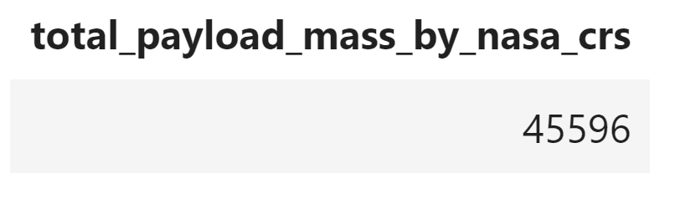
Total Payload Mass
The total payload mass (in Kg) carried by boosters from NASA is displayed below.
The SQL query uses SUM and a WHERE clause to restrict customer to ‘NASA (CRS)’.

Slide 26
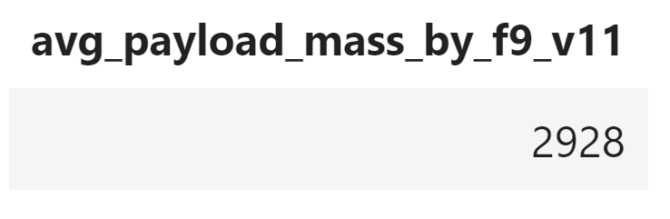
Average Payload Mass by F9 v1.1
The average payload mass (in Kg) carried by booster version F9 v1.1 is displayed below.
The SQL query uses AVG and a WHERE clause to restrict the booster version to ‘F9 v1.1’.

Slide 27
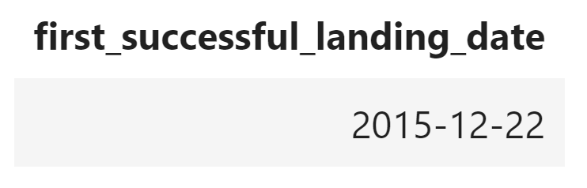
First Successful Ground Landing Date
The date (in YYYY-MM-DD) of the first successful landing outcome on ground pad is displayed below.
The SQL query uses MIN and a WHERE clause to restrict landing outcome to ‘Success (ground pad)’.

Slide 28
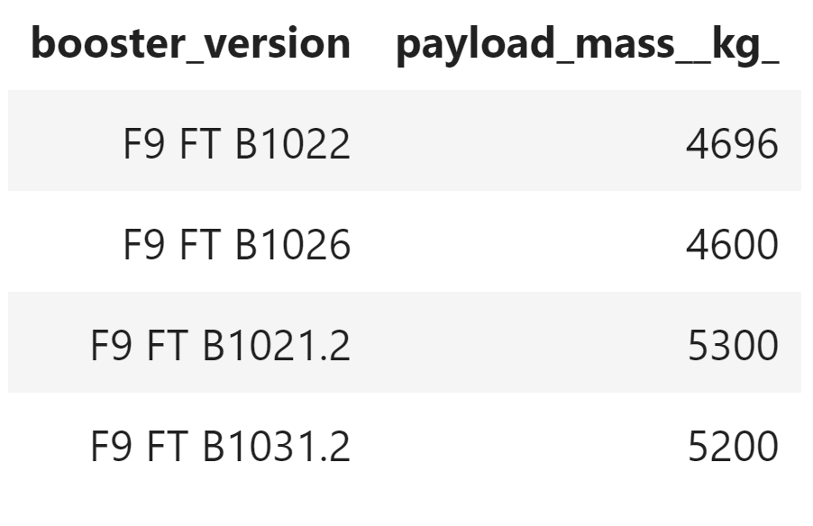
Successful Drone Ship Landing with Payload between 4000 and 6000
List of the names of booster versions which have successfully landed on drone ship and with a payload mass greater than 4000 but less than 6000.
The SQL query uses a WHERE clause to restrict landing outcome to ‘Success (drone ship)’ and BETWEEN for payload mass interval.

Slide 29
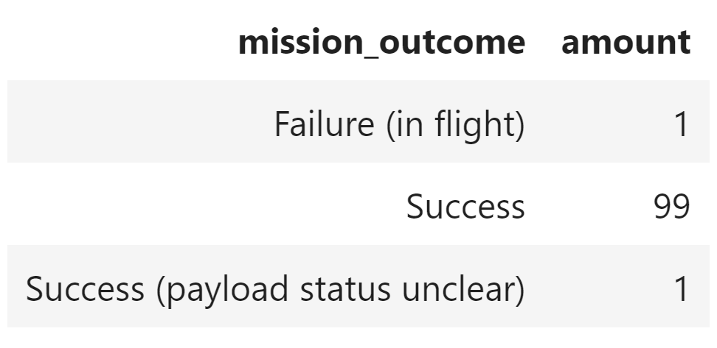
Total Number of Successful and Failure Mission Outcomes
Total number of successful and failure mission outcomes. The successes are 99 plus 1 with unclear payload status; failure is only 1.
The SQL query uses COUNT to compute the amount of mission outcomes and GROUO BY to group with respect to mission outcomes.

Slide 30
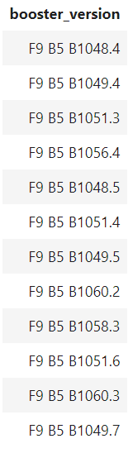
Boosters Carried Maximum Payload
List of the names of the booster versions which have carried the maximum payload mass (equal to 15.600 Kg).
The SQL query uses subquery with the MAX function in the WHERE clause to require that the payload carried is equal to the maximum.

Slide 31
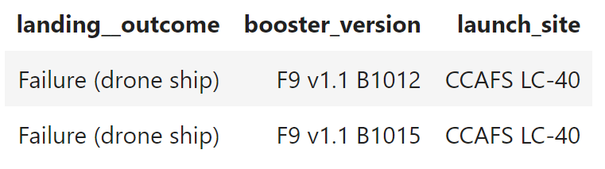
2015 Launch Records
List of the failed landing outcomes in drone ship, their booster versions, and launch sites names for the year 2015.
The list contains two different booster version, but all launches took place at CCAFS LC-40.
The SQL query uses LIKE to select failure and the YEAR function to filter for 2015 in the WHERE clause.

Slide 32
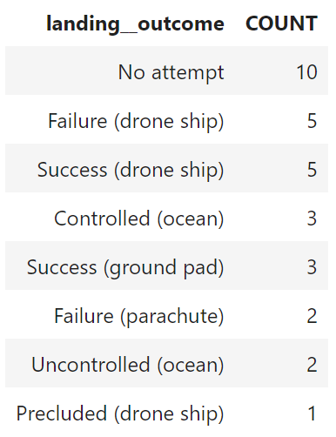
Rank Landing Outcomes Between 2010-06-04 and 2017-03-20
Descendent rank of the count of landing outcomes (such as Failure (drone ship) or Success (ground pad)) between the date 2010-06-04 and 2017-03-20.
The SQL query COUNT to compute the amount of landing outcomes. Moreover, it uses BETWEEN to select the time interval in the WHERE clause, GROUP BY to group by landing outcomes and the ORDER request in DESC mode.

Slide 33

Section 3

Slide 34
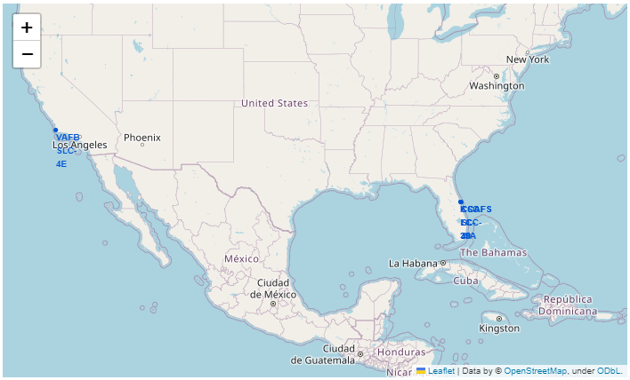
SpaceX Launch Sites
Blue markers indicate where launch sites are placed.
The map clearly show that all launch sites are positioned to be near the coast.

Slide 35

Success and Failure for Launch Sites
Yellow circles are added to launch sites. The circles display the number of launch for each region.
Zooming in the iterative map the number of launch become more precise by separating on specific different launch sites.

Slide 36
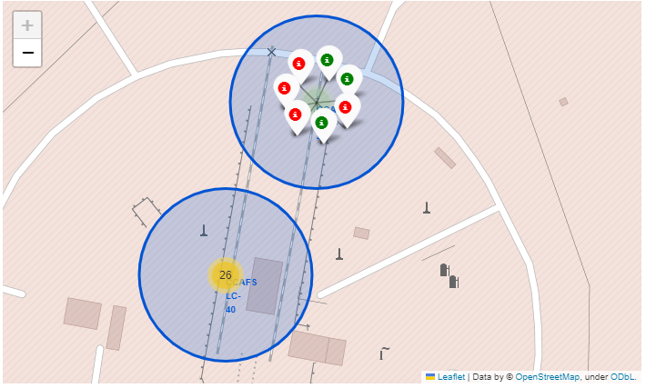
Success and Failure for Launch Sites
Keeping zoom in, the map display for each launch site a popup markers denoting whether launches were successful or not.
Red markers denote a failure while green denote a success.

Slide 37
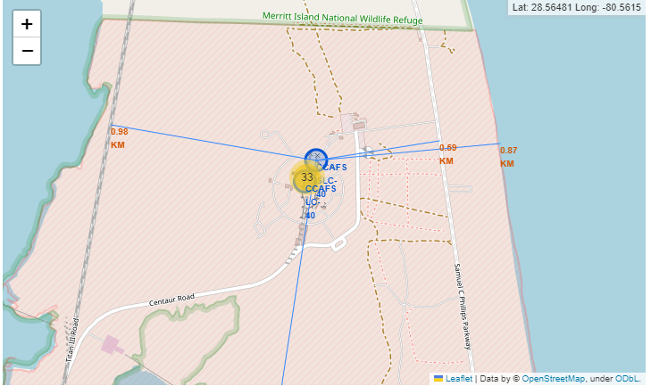
Launch Sites Distances with Proximities
The map shows for a selected launch site the distances to its proximities: railway (0.98 Km), highway (0.59 Km), coastline (0.87 Km) and city (18.16 Km).
Launch sites are near highways and railways for transport reasons and distant from cities for security reasons.

Slide 38

Section 4

Slide 39
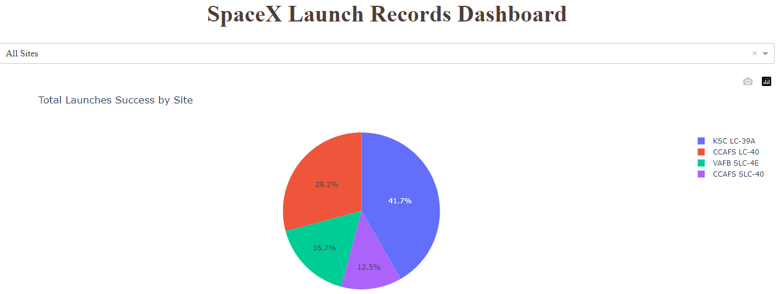
Total Launches Success by Site
The pie-chart show that KSC LC-39A has the higher success amount (41.7% of all successes); the worst is CCAFS SCL-40 with only the 12.5%.

Slide 40
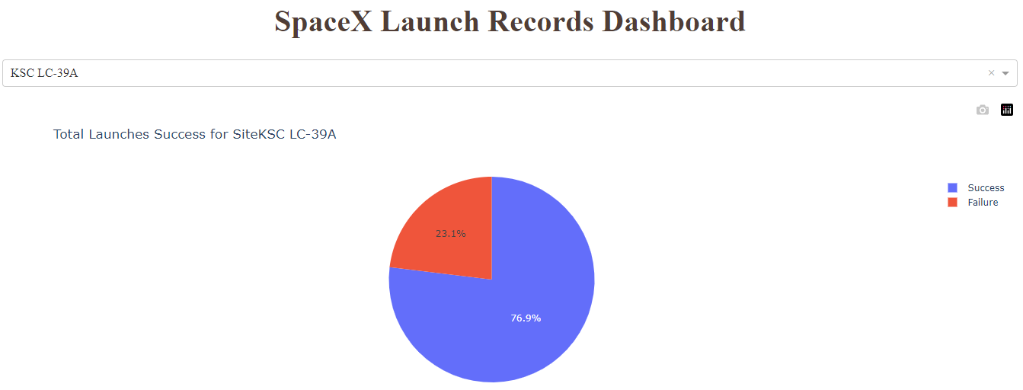
Success vs Failure for KSC LC-39A
The pie-chart display for KSC LC-39A (the launch site with highest launch success ratio) its percentage of success (76.9%) and of failure (23.1%).

Slide 41
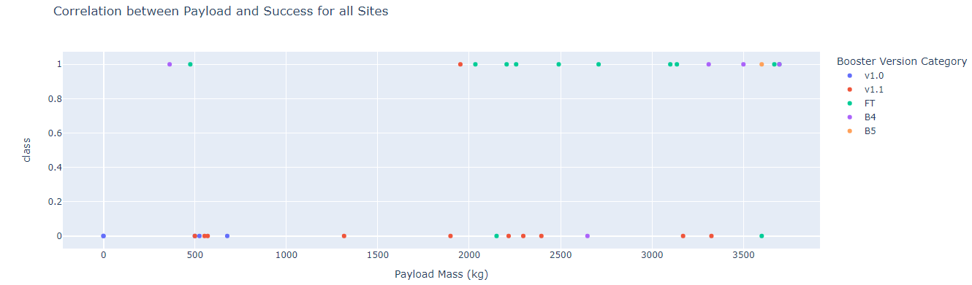
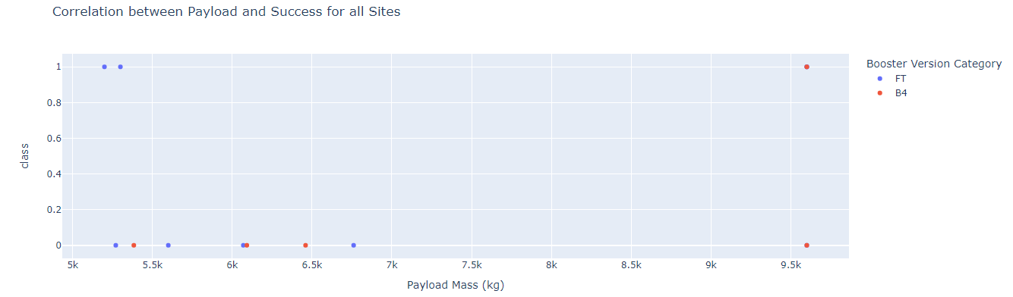
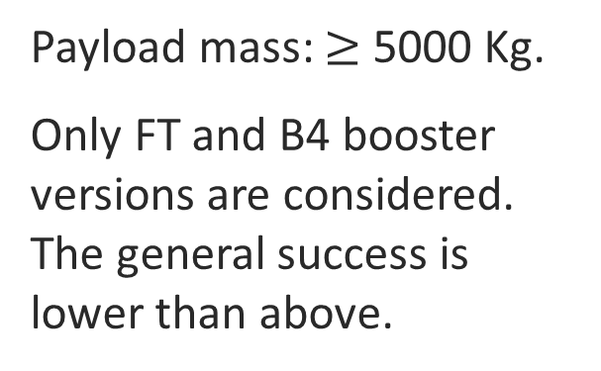
Payload vs. Launch Outcome
We display a payload mass vs. launch outcome scatter plot for all launch sites.
Payload mass: 0 - 4000 Kg.
A good success rate for FT and B4 booster version is shown.
Payload mass: $≥$ 5000 Kg.
Only FT and B4 booster versions are considered. The general success is lower than above.

Slide 42

Section 5

Slide 43
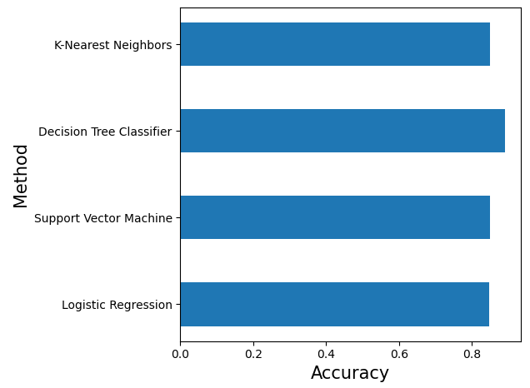
Classification Accuracy
We compare the accuracy of the following methods:
Logistic Regression
Support Vector Machine
Decision Tree Classifier
K-Nearest Neighbor.
The method with the highest classification accuracy is Decision Tree with an accuracy of 0.89.

Slide 44
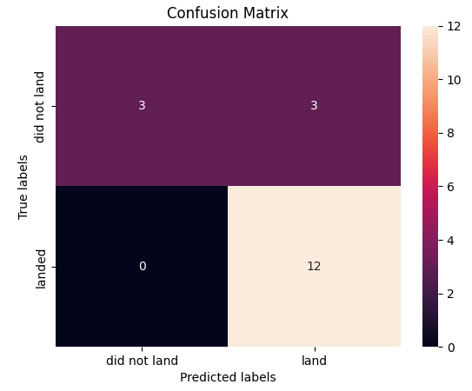
Confusion Matrix
Here displayed the confusion matrix for the best performing model.
The model predict correctly all the 12 successful landing (True Positive), while it predicts correctly only 3 over 6 unsuccessful landings (True Negative) and fails by predicting successful 3 unsuccessful landings (False Positive).

Slide 45
Conclusions
The analysis verifies an increasing success rate trend for rocket launches over years. The success is also positively correlated to the number of flight.
The orbits where launches were the most successful ES-L1, GEO, HEO and SSO.
The launch site with highest launch success ratio is KSC LC-39A.
The success rate seems to be correlated to payload mass: lower payload masses correspond to a higher success rate.
The launch sites are placed near transportation infrastructure and far away from cities for safety reasons.
The best predictive method is the Decision Tree Classifier with an accuracy of 89%.

Slide 46
Appendix
GitHub Repository: https://github.com/ChiaraBrambilla96/Final-Assignment-Data-Science

Slide 47


